Slide 1

Online Sales Forecasting
Haolong Liu
Taichen Zhou
Yichen Huang

Slide 2



Agenda
Problem and Business Value
Project Milestones and Timeline
Data Sources
Data Preprocessing
Data Analysis
Pre-Modeling
Model
Results
Challenges and Future Steps

Slide 3




Introduction
The Online Retail data set contains all the transactions occurring for a UK-based and registered, non-store online retail between 01/12/2009 and 09/12/2011. The company mainly sells unique all-occasion giftware. Many customers of the company are wholesalers.

Slide 4

Problem
Value Creation
Bad debt appears multiple times in the sales data of 2 years period and supply chain can be better improve when applying analysis and forecasting techniques are implemented
Reduce Inventory Cost
Objective
Apply Forecasting and Machine Learning Techniques to Predict Daily Sales in the Future
Optimize Supply Chain
From:
To:
Feb 1st, 2023
Mar 3rd, 2023
Increase Sales Profit

Slide 5
Timeline
Data Exploration
Forecasting techniques and ML Model Shallow Taste
Select best model with lowest MAPE
Milestone 1
Milestone II
Deliverable 1
Milestone 3
Deliverable II
Data Preprocessing and Data Analysis
Predicting Model Choosing and Hyperparameter Tuning

Slide 6
Data
The data is downloaded from UCI Machine Learning Repository, Online Retail Data.
Attribution information:
InvoiceNo: Invoice number. A 6-digit integral number uniquely assigned to each transaction. If this code starts with letter 'c', it indicates a cancellation
StockCode: Product code. A 5-digit integral number uniquely assigned to each distinct product
Description: Product (item) name
Quantity: The quantities of each product (item) per transaction
InvoiceDate: Invoice Date and time. The day and time when each transaction was generated
UnitPrice: Unit price. Numeric, Product price per unit in sterling
CustomerID: Customer number. A 5-digit integral number uniquely assigned to each customer
Country: Country name. The name of the country where each customer resides.

Slide 7
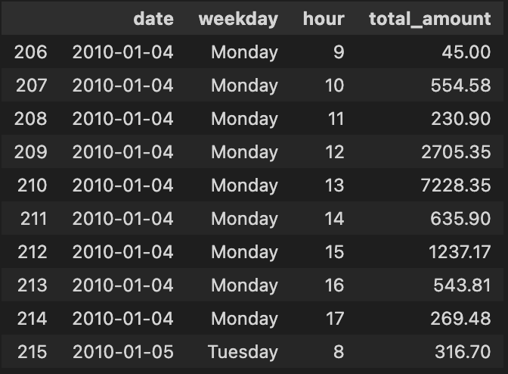
Data Preprocessing
Target Variable: quantity times the price for each transaction and renamed as “total_amount”
Only focus on the sales data in United Kingdom so data from other countries are dropped
Price and quantity which are lower than 0 for example, bad debt are dropped
Extract “weekday”, “hour” from the date attributes and dataset is grouped by hourly.
Integrate weather data collected by the weather station in Heathrow Airport to the original dataset.

Slide 8
Data Analysis
Quarterly & Monthly Analysis
Weekly Analysis
Daily Transaction Analysis
Quarterly Sales
Monthly Sales
Monthly Sales Count
Add text, images, art, and videos.
Add transitions, animations, and motion.
Save to OneDrive, to get to your presentations from your computer, tablet, or phone.
Open the Design Ideas pane for instant slide makeovers.
When we have design ideas, we’ll show them to you right there.
Add text, images, art, and videos.
Add transitions, animations, and motion.
Save to OneDrive, to get to your presentations from your computer, tablet, or phone.
Open the Design Ideas pane for instant slide makeovers.
When we have design ideas, we’ll show them to you right there.

Slide 9
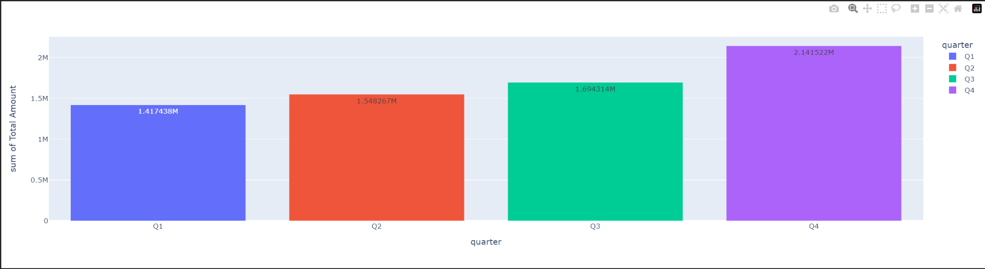
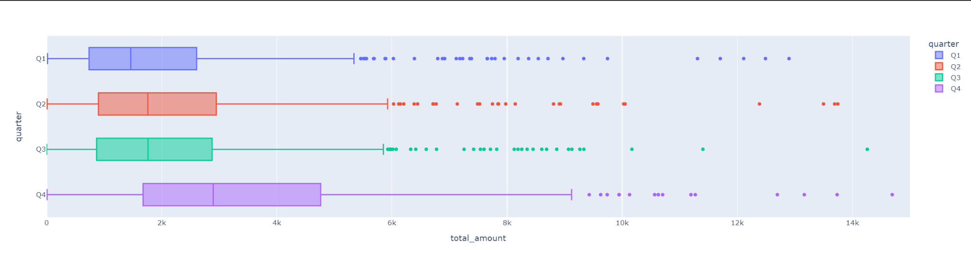
Quarterly Analysis
Although, Q4 has the lowest purchase frequency, it has the highest amount of sales amount.
We assume this pattern is highly related to the holiday season like Thanksgiving and Christmas.

Slide 10
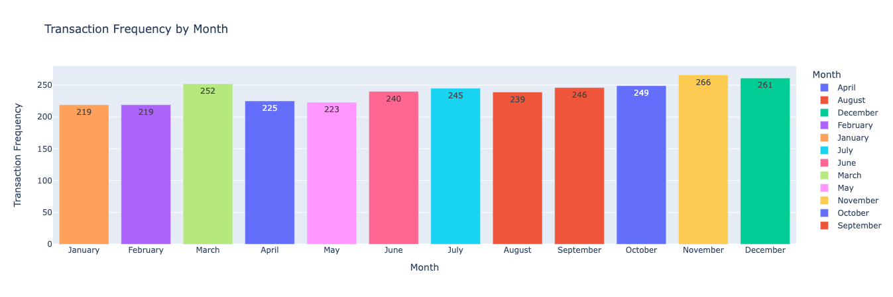
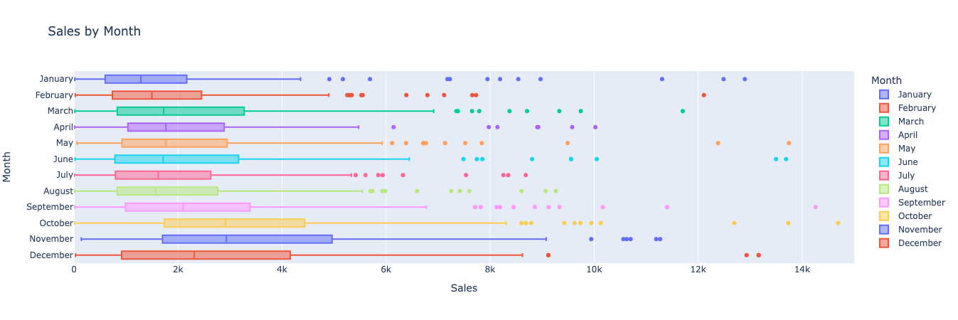
Monthly Analysis (2010)
From the Transaction Frequency by Month Chart, there is no significant difference or trend from January to December.
From the Sales by Month Box Plot, the sales from September to December is significantly higher than rest of the year.
Because the transaction frequency is about the same for each month, it is reasonable to conclude that the quantity of each order is higher from September to December.

Slide 11
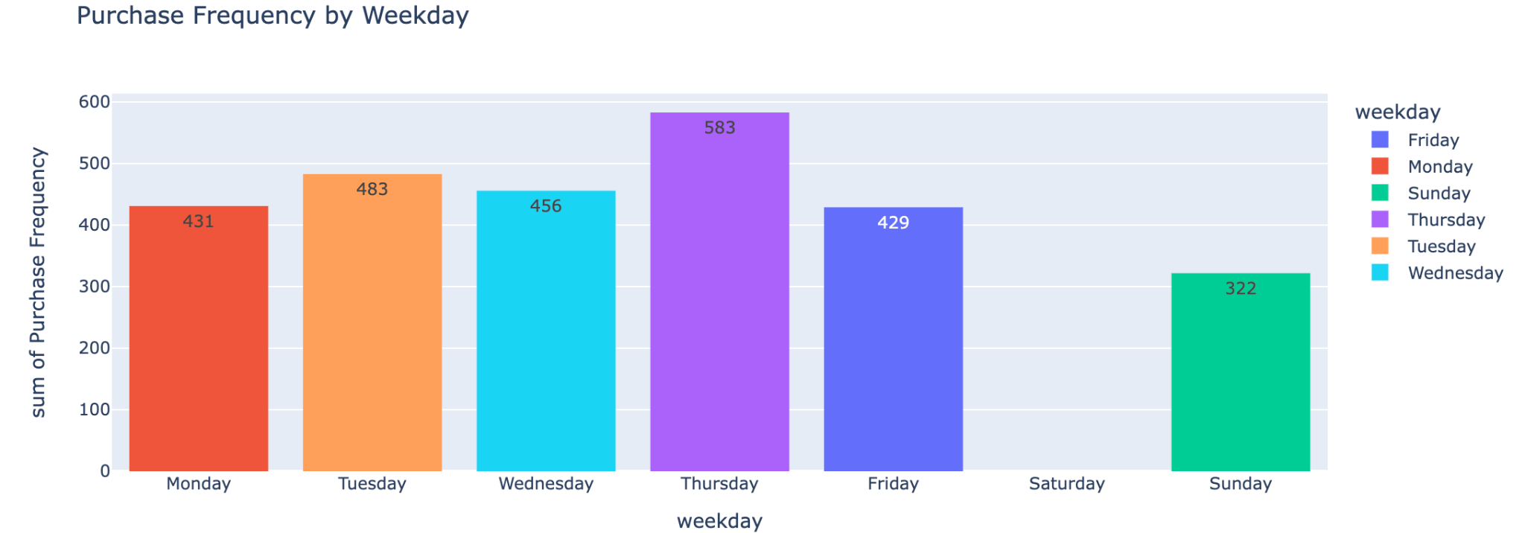
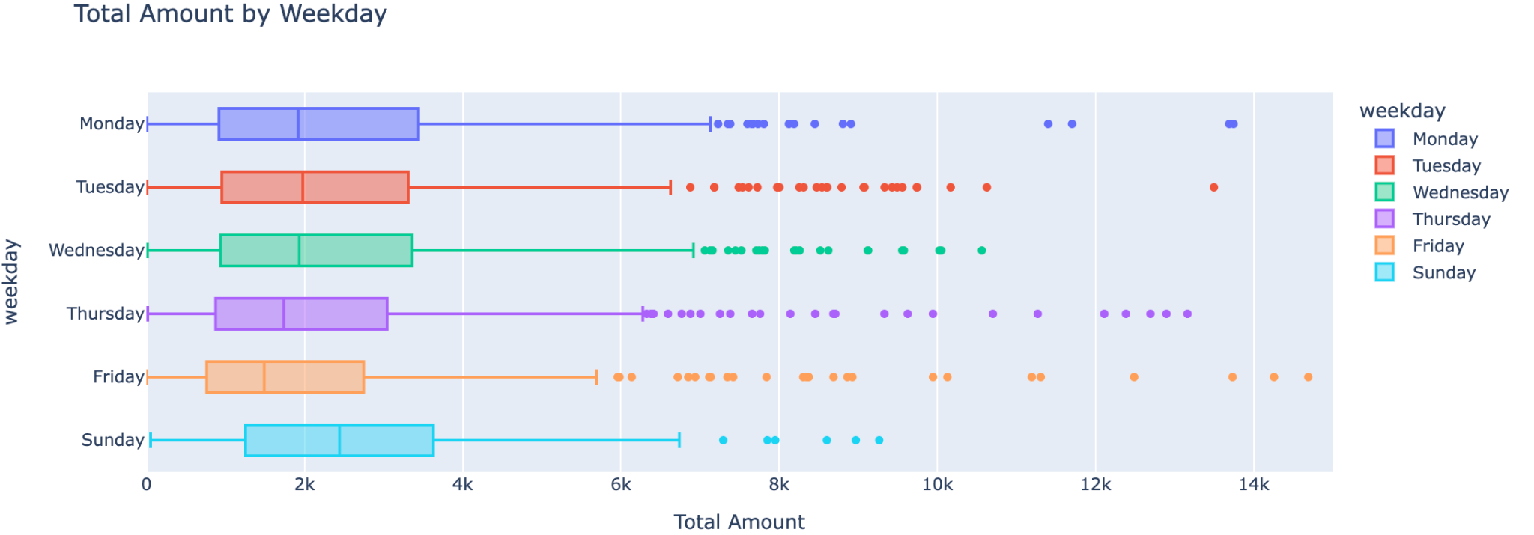
Weekday Analysis
From the histogram above, Thursday has the highest number of purchases and Sunday has the lowest.
From the boxplot below, Sunday has the highest median of total sales.
The data is missing for Saturday.
We speculate that Sunday as the end of the week might be the best time for buyers to prepare for the upcoming weekday.

Slide 12
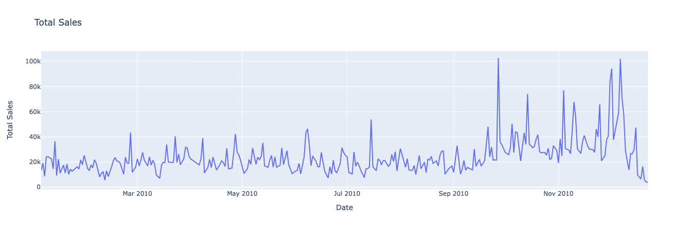
Daily Analysis

Slide 13
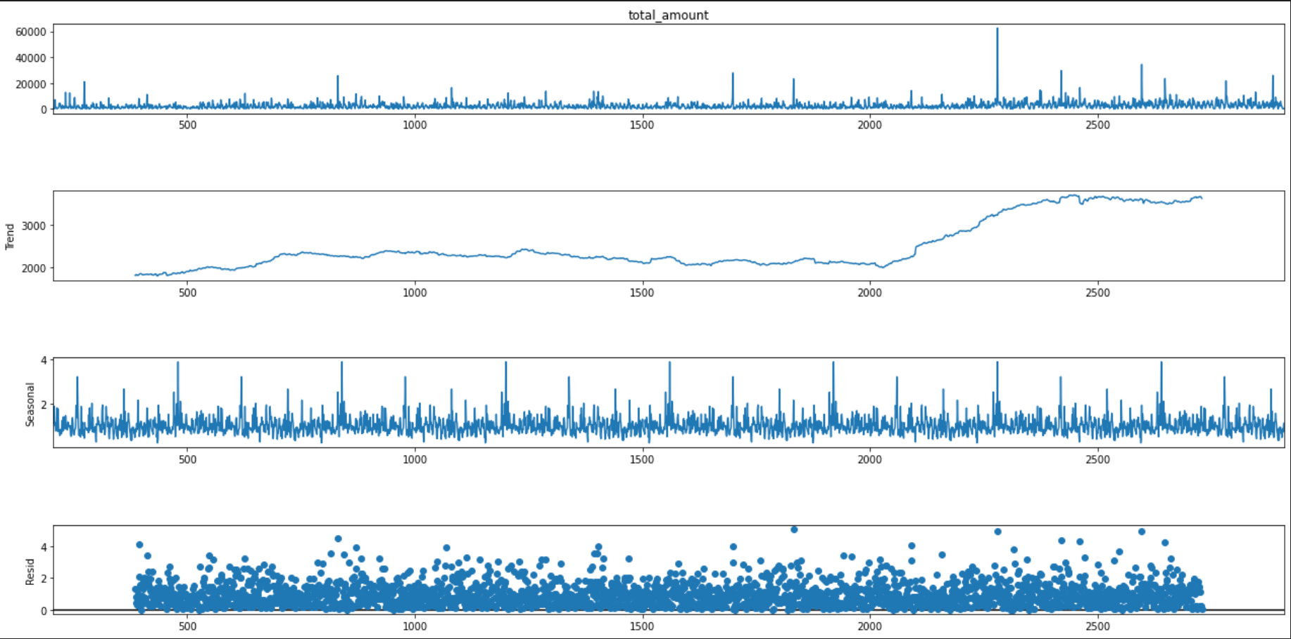
Pre-modeling
Seasonal Decomposition - Hourly
Before modeling, we did some analysis to the seasonality and trend of the original time-series dataset.

Slide 14
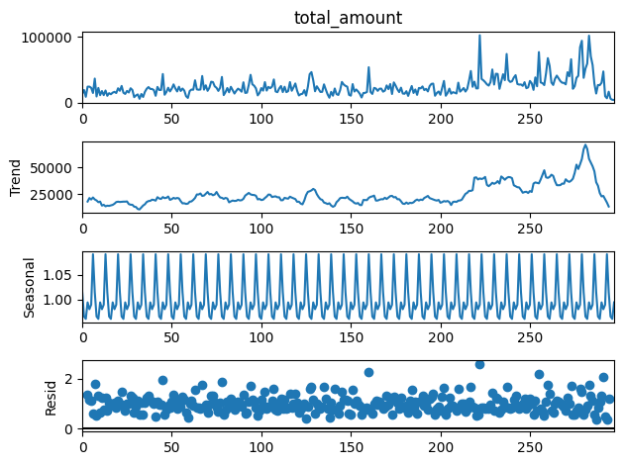
Seasonal Decomposition - Daily

Slide 15
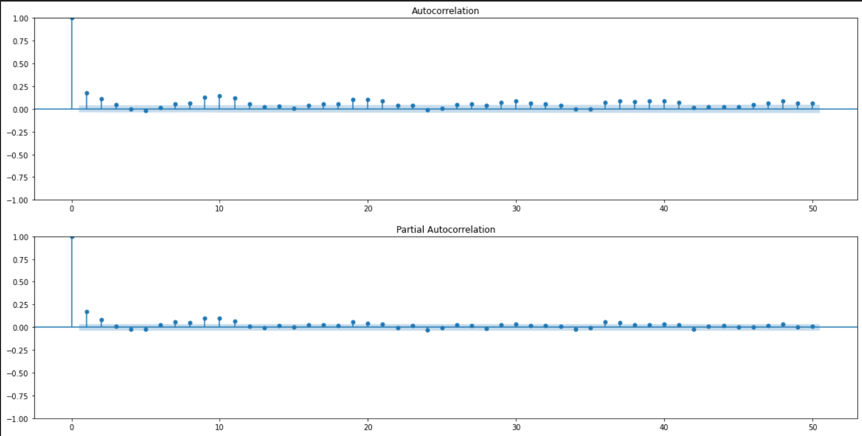
ACF and PACF Analysis
From the graphs of ACF and PACF, two graphs seem to have geometric decay but no clear cut-off. So, we assume that ARIMA or SARIMAX model might be a good fit to this dataset.

Slide 16
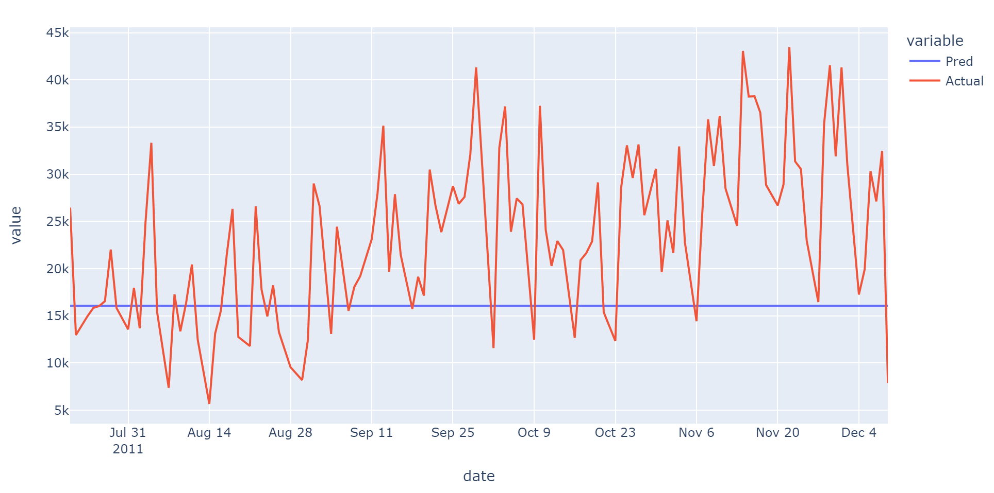
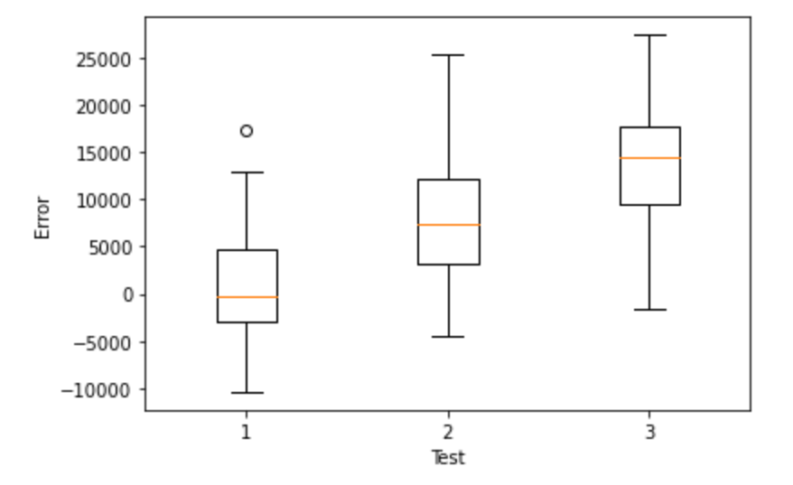
Model - SARIMAX
After using gridsearch for the best combination of (p,d,q), (4,1,4) yield the best result while the AIC and BIC in this case are still really high. When using this model to predict the last 2 months of the dataset, mean absolute error is also high.
So, we are considering to combine some of the hours to a longer time period to decrease some data scrambling.
Also, more complex time-series models need to be implemented.

Slide 17
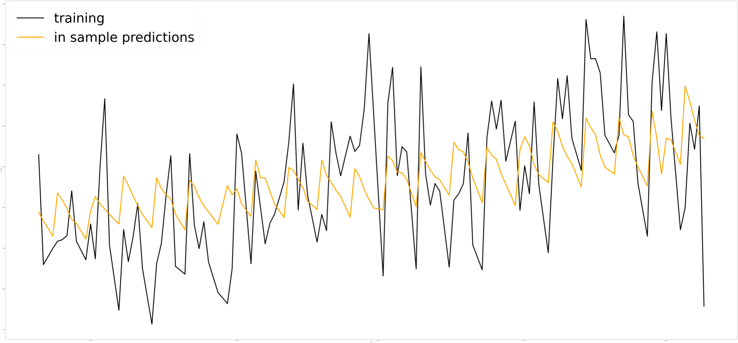
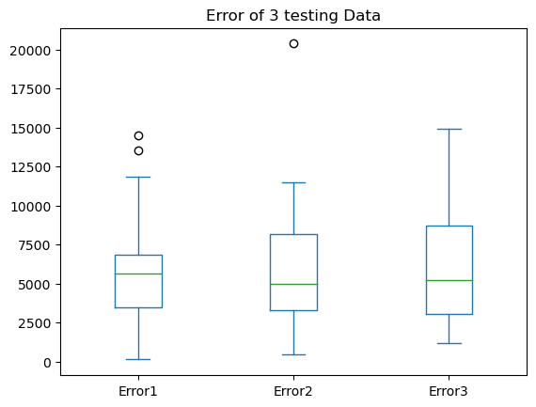
Model - GLM
Because GLM cannot handle date-time type data, quarter, month, day in the month, and weekday are extracted from the date. Also, the holiday days in the UK From 2009 to 2011 are marked for tracking the holiday season trend. Daily weather data collected by the weather station at Heathrow Airport are also implemented.
After using OLS, Poisson, Gaussian, and Gamma regression in the GLM model to fit the data, the Poisson regression yields the best result.

Slide 18

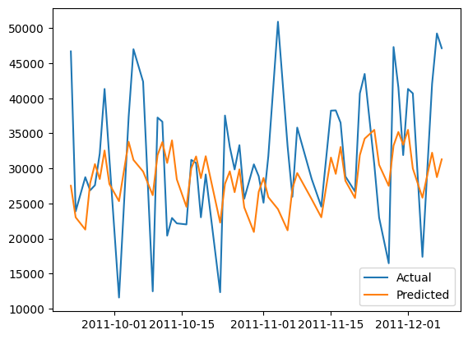
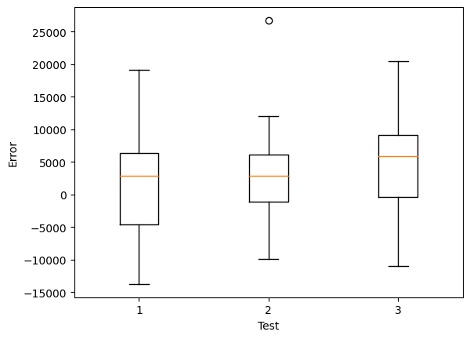
Model -
The Facebook profit can make the prediction which very close to the true value by its ability to handle seasonality, holiday, trend, and errors
After hyper-parameter tuning, the MAPE is close to 0.24606
From the first plot, in the middle part the predicted value is close to the real-value
The second figures shows the distribution of the error for each part of testing data

Slide 19
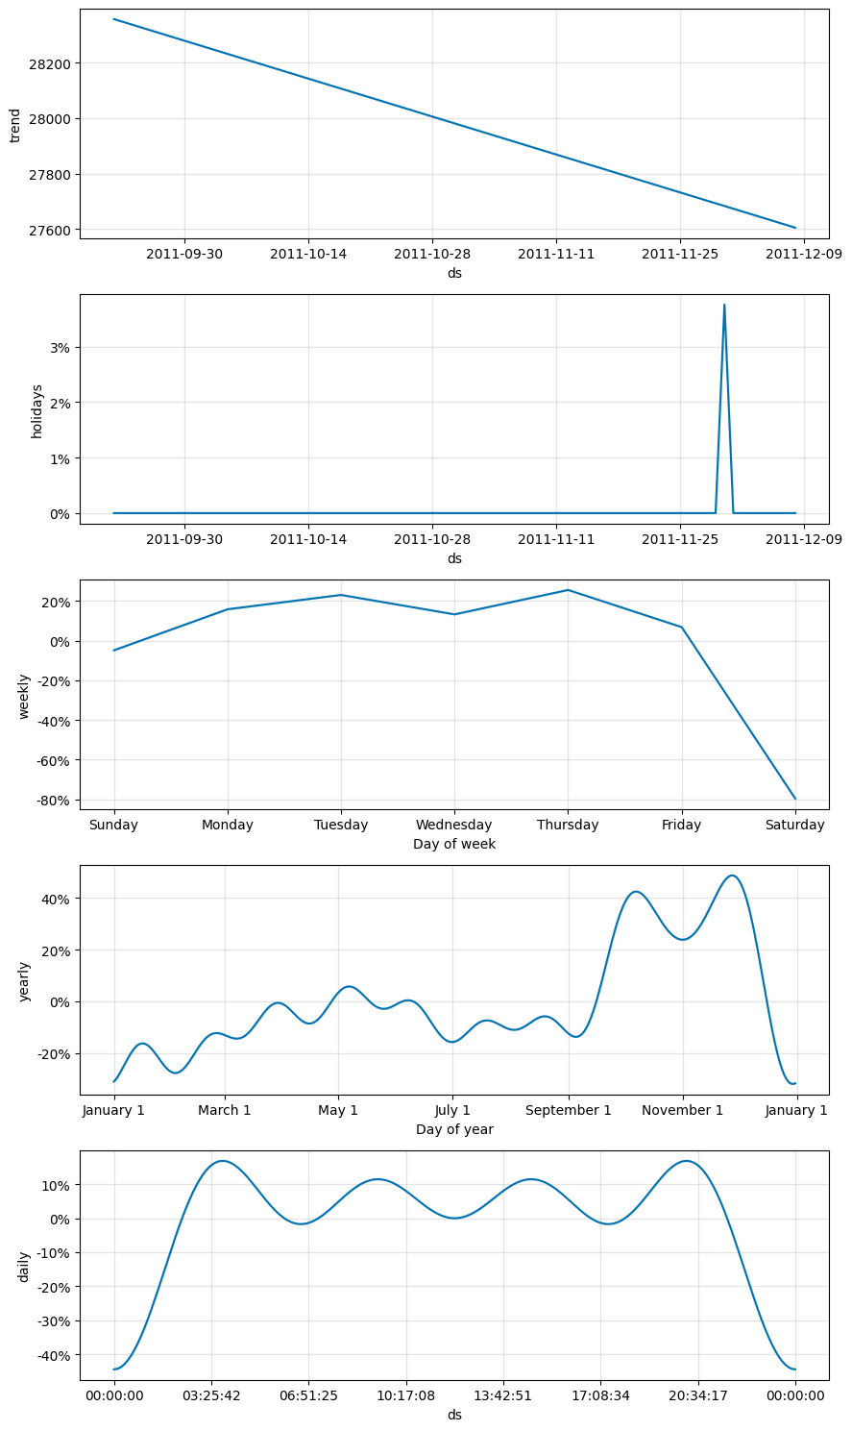
Model -
The plot shows the trend, holidays, daily seasonality, weekly seasonality, and yearly seasonality.
The yearly seasonality subplot shows the holiday season which also shows in the holiday subgraph.
The weekly seasonality subplot shows the sales in every Saturday is low which is clearly shows in the data exploration stage.

Slide 20

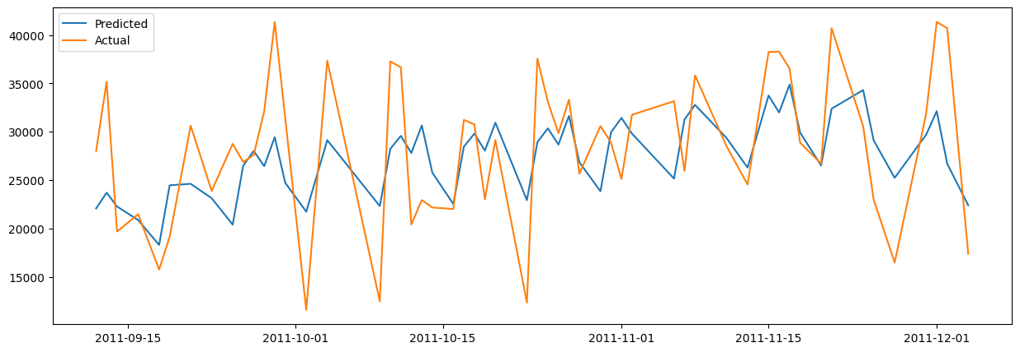
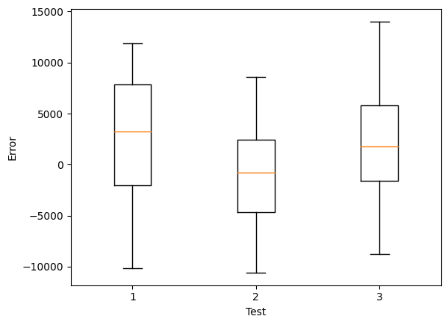
Model -
With application of neural networks, the accuracy of prediction by the model is higher than Facebook Prophet model
From the box plot, the error for all part of testing data is lower than Prophet model, especially the second part, the medium is close to zero

Slide 21
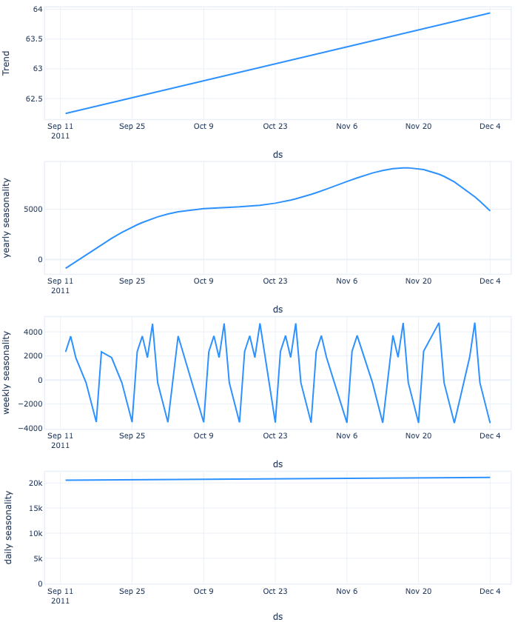
Model -
The plot displays various trends, including daily seasonality, weekly seasonality, and yearly seasonality
The yearly seasonality subplot highlights the holiday season, which is also evident in the holiday subplot
The weekly seasonality subplot reveals that sales tend to be lower on Saturdays, a finding that was already apparent during the data exploration stage.

Slide 22
Table of Results
Model | SARIMAX | GLM | Prophet | Neural Prophet
Testing1 | 0.30438 | 0.43457 | 0.31184 | 0.24937
Testing2 | 0.32932 | 0.26476 | 0.19802 | 0.18288
Testing3 | 0.44467 | 0.27447 | 0.22921 | 0.16387
MAPE | 0.35946 | 0.32419 | 0.24606 | 0.19807
Github Link: https://github.com/yichuang25/Forecasting-Project-Sales
Email Yichen Huang(yichen.huang@columbia.edu) to get the access of the github

Slide 23

Challenge & Future Steps
In the future, we will try to change different ways of cleaning the data and feature engineering. Also, more hyperparameter tuning and predicting models will be implemented. Best wishes to the next group and hopefully they can make a good progress based on our work.

